Slide 1
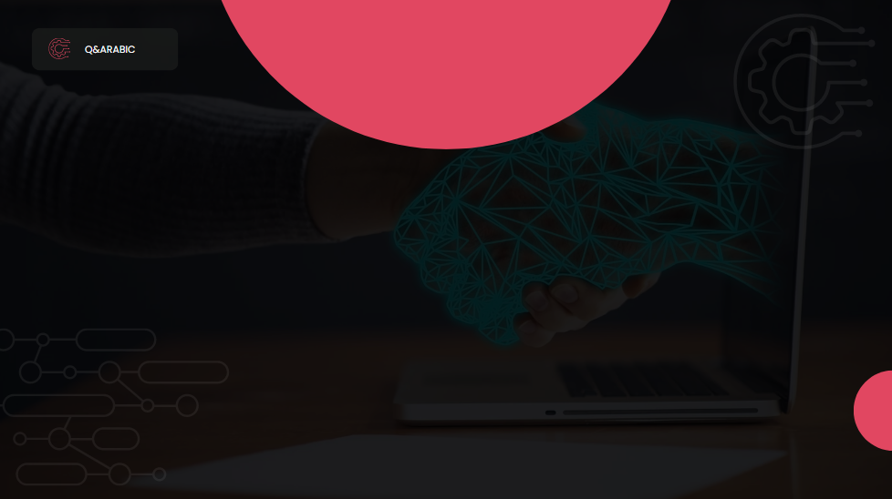
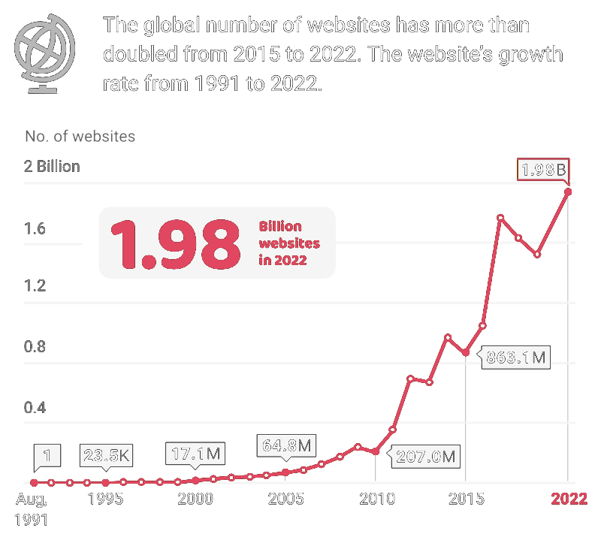
Number of Websites in the world
Source: www.internetlivestats.com
Notes:
20s

Slide 2
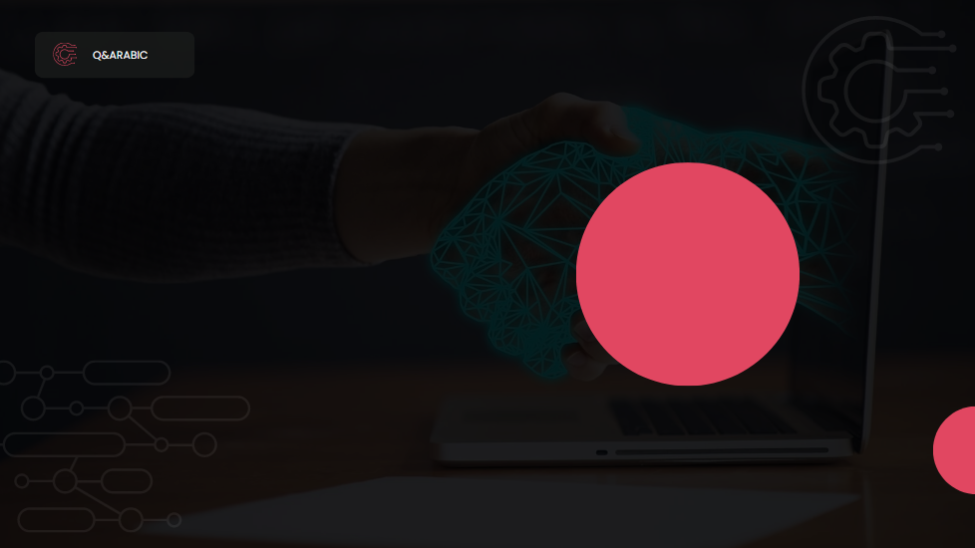
Q&Arabic
An Automatic Questions & Answers FAQ Generator
Notes:
5s

Slide 3
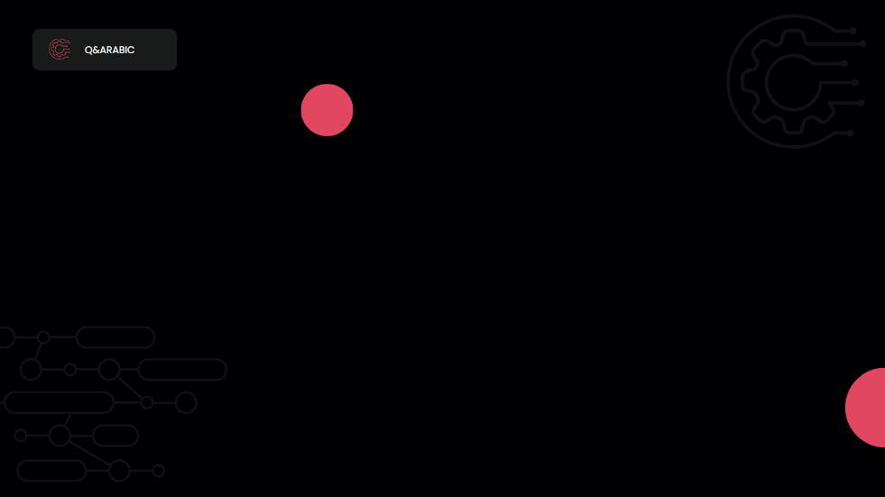
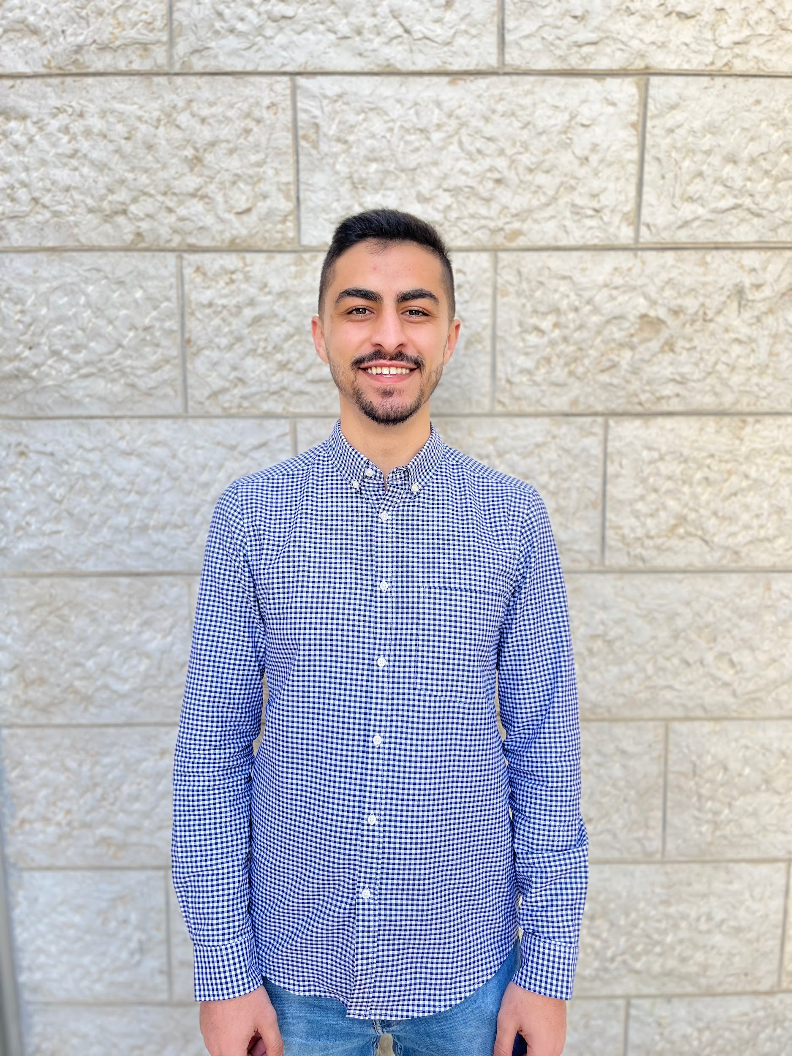
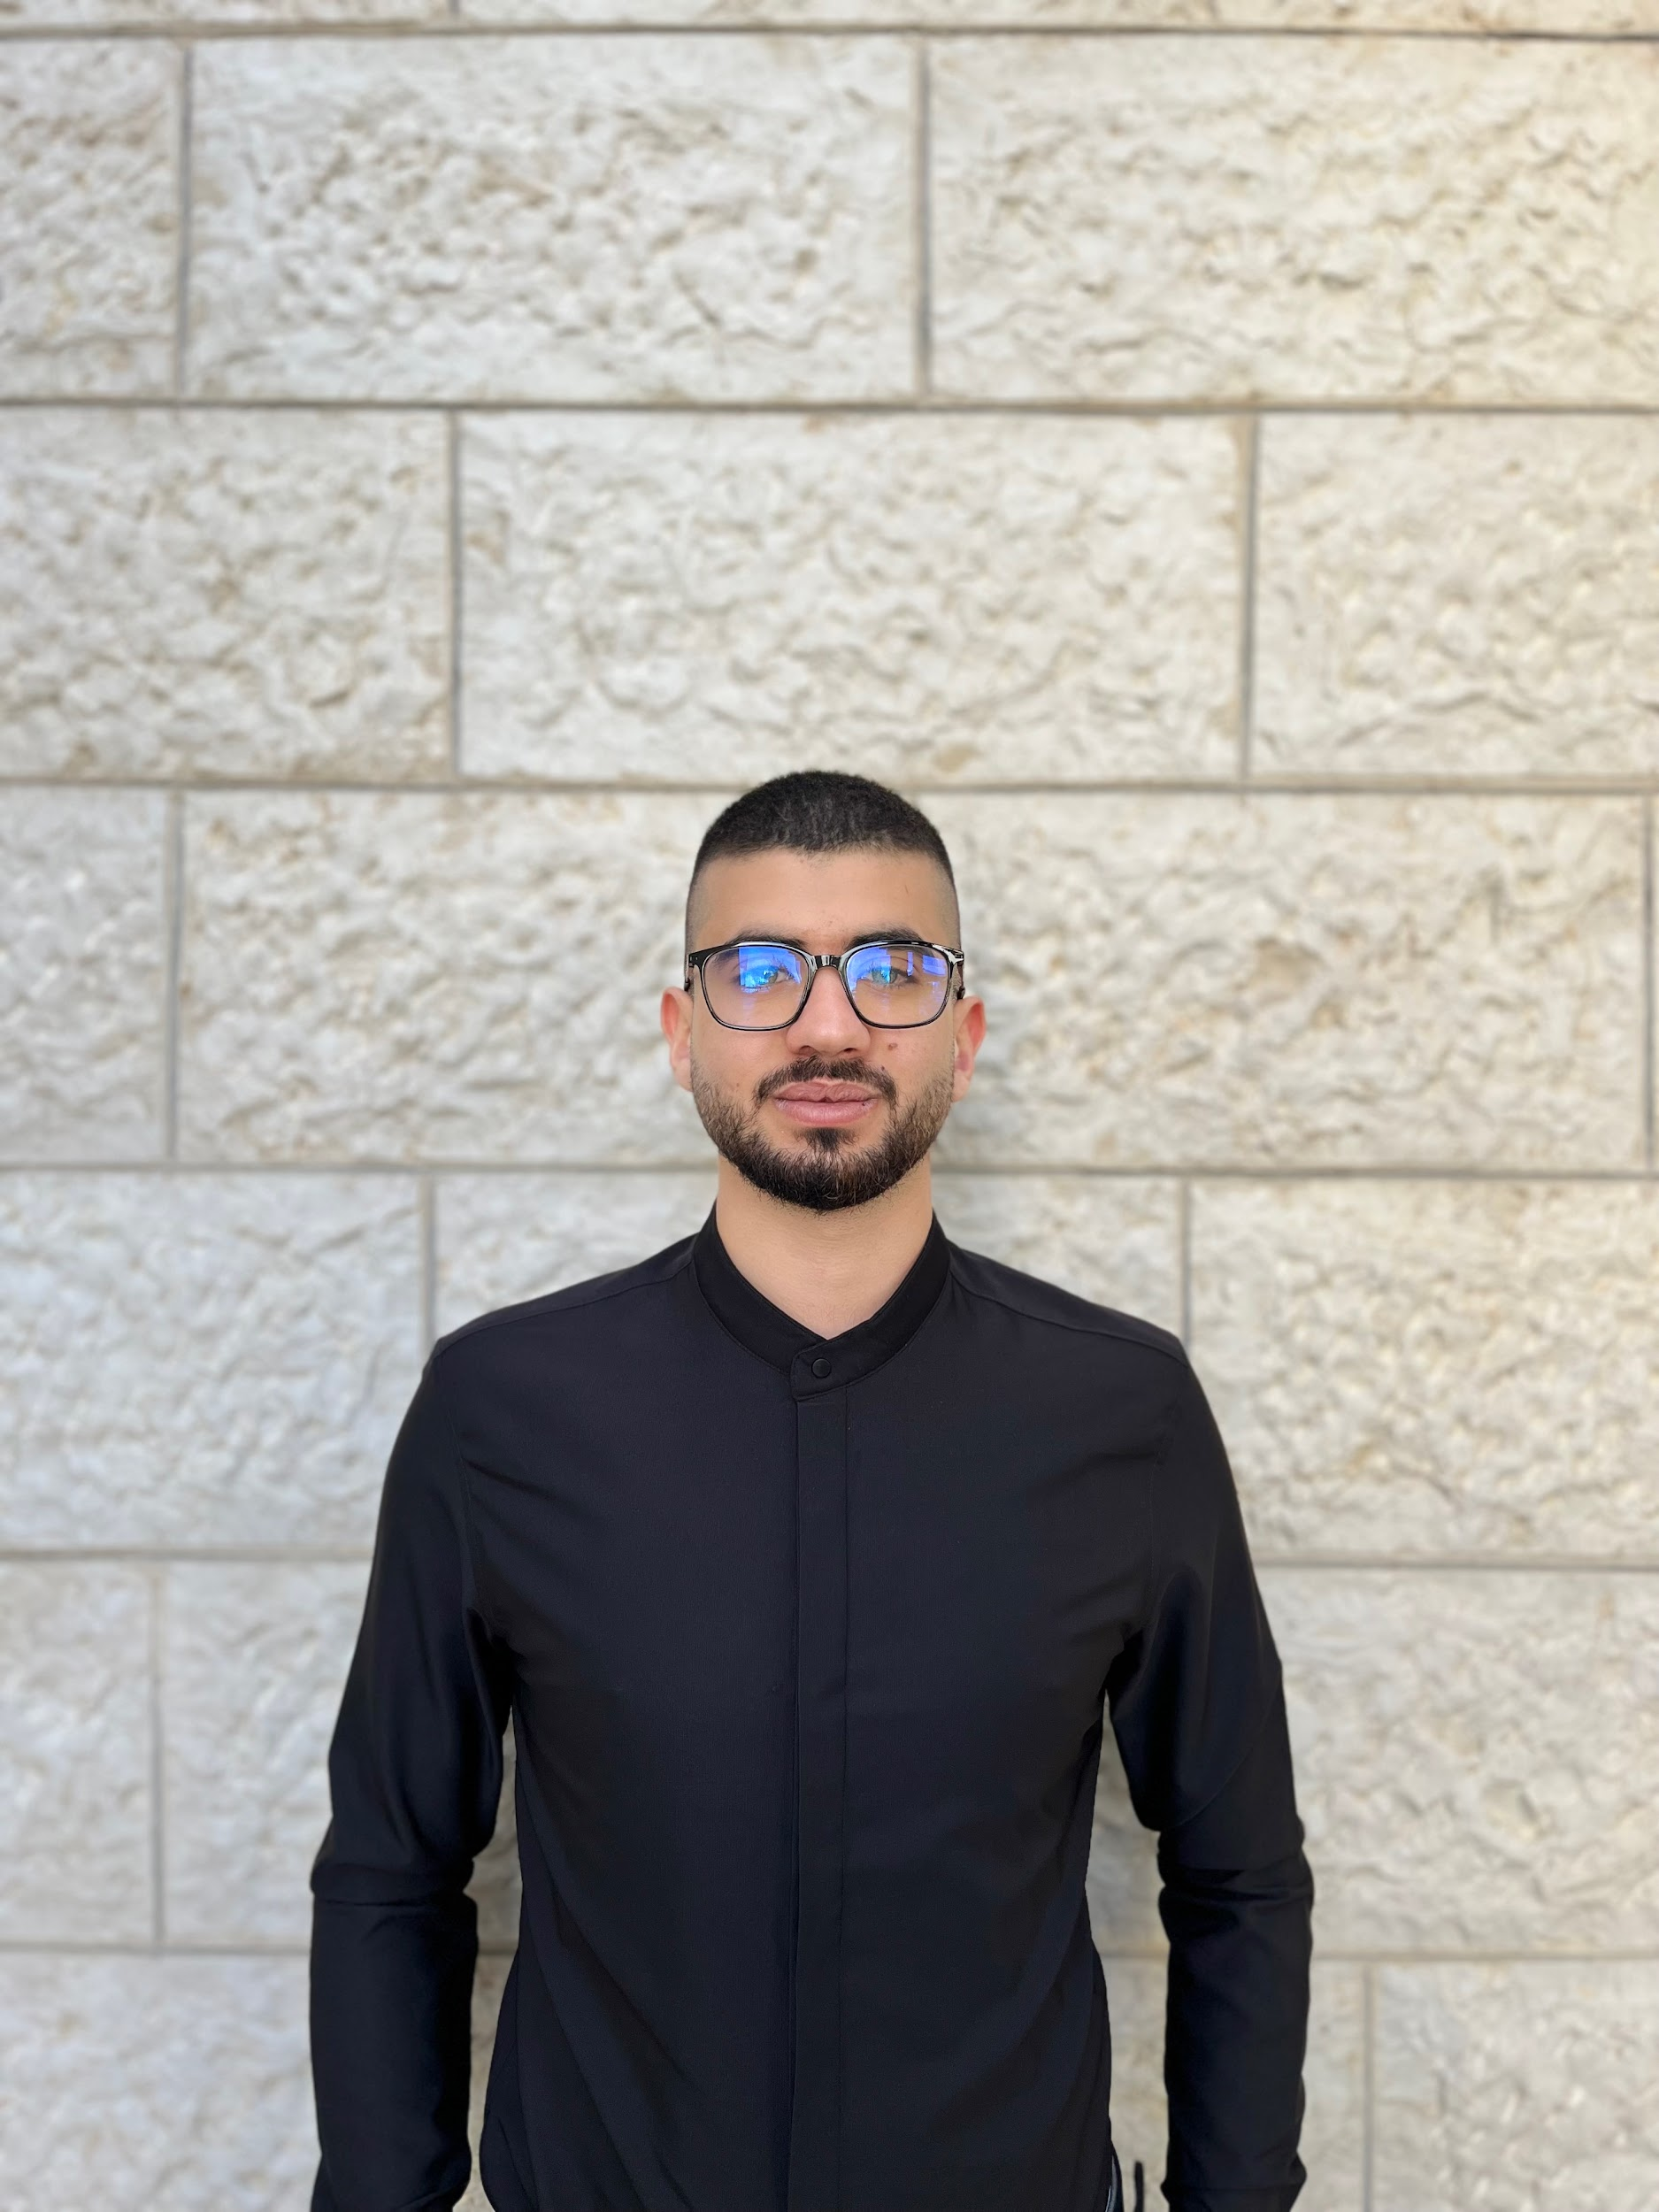
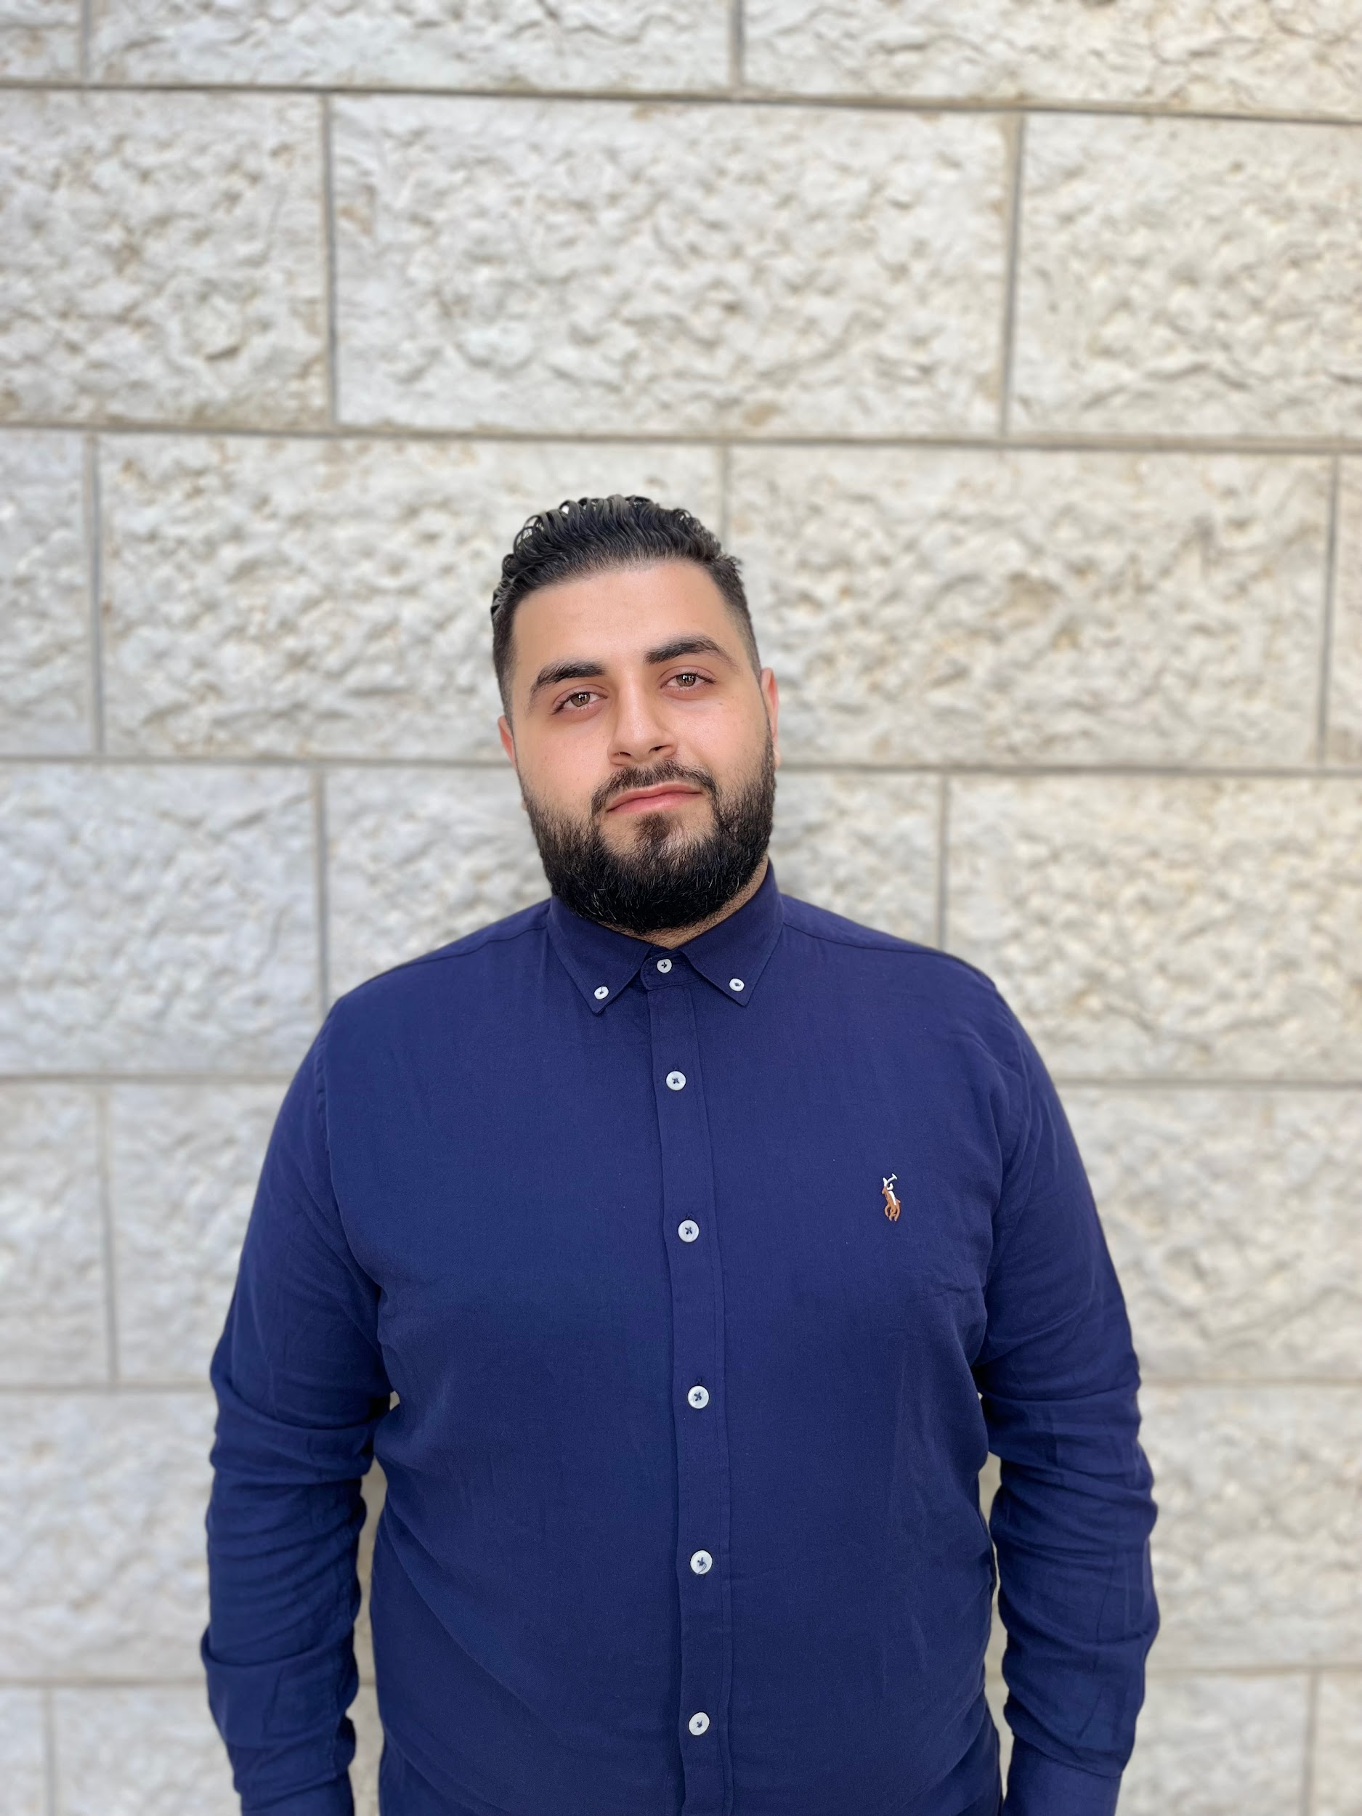
Meet Our Team
Karim Halayqa
Obada Tahayna
Momen Bazzar
Supervisor: Dr. Radi Jarrar
Notes:
12s

Slide 4
Outline
Introduction
Background, Literature Review and Related Work
Proposed System
System Design
Future Plan
Notes:
15s

Slide 5
MOTIVATION
Notes:
1m

Slide 6
Aims and Objectives
Efficient solution for Arabic Q&A automation.
Contribution to ML and NLP for the Arabic language.
Web-based platform for Arabic FAQs generation.
Design, implement, evaluate, and test Q&A system.
Notes:
1m 15s
– 40s

Slide 7
Background &
Literature Review
Notes:
3m

Slide 8
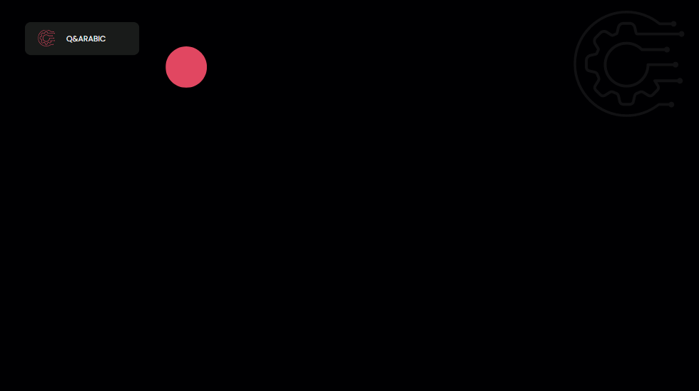
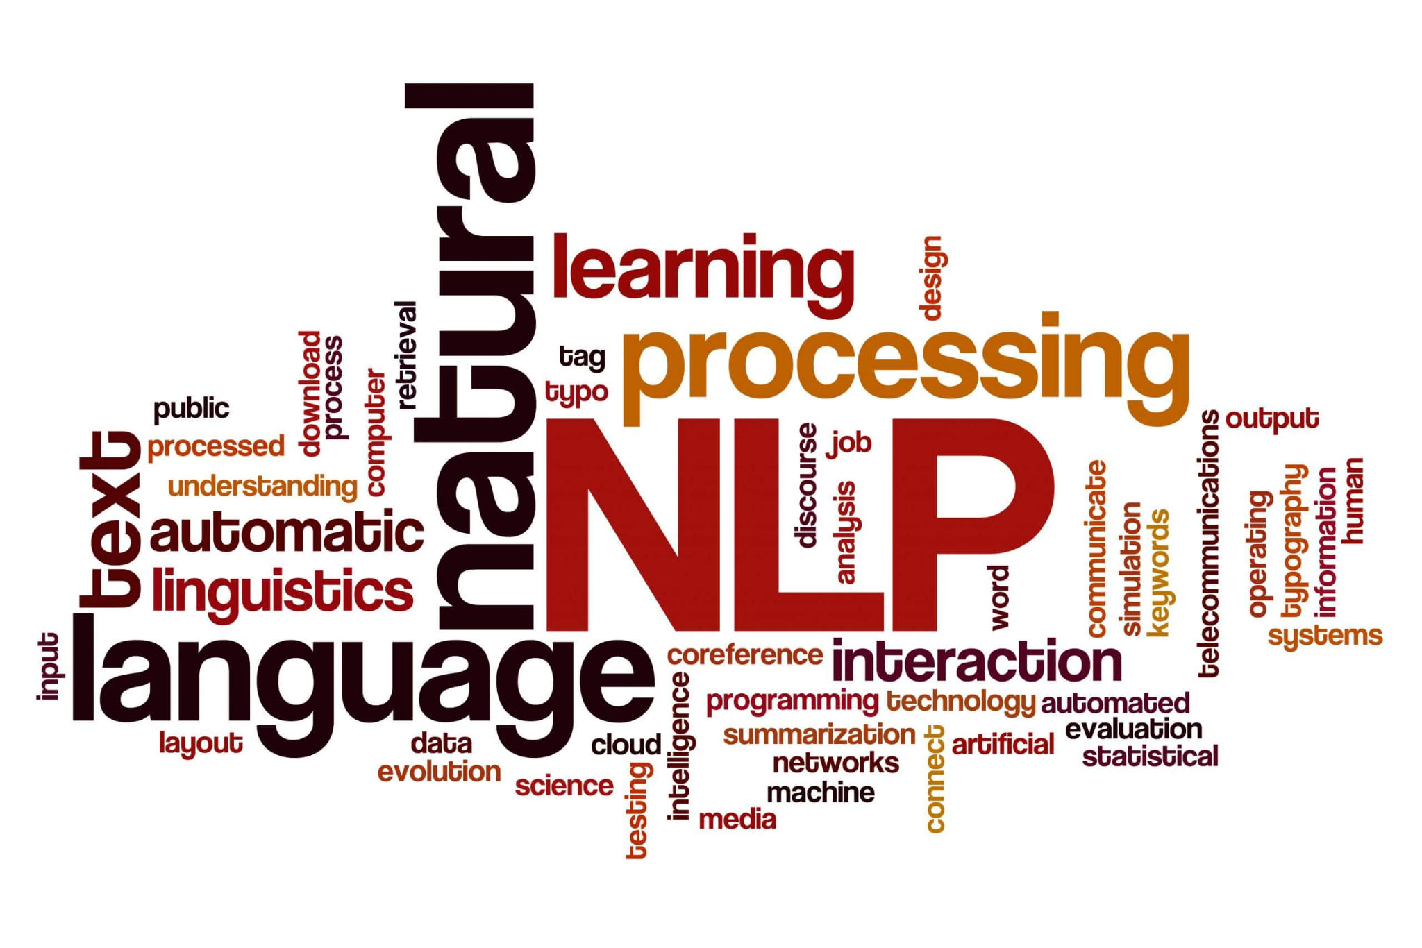
Natural Language Processing
Notes:
30s
Talk briefly about what NLP is and its applications.
A few examples of applications to NLP such as text classification, text summarisation, text annotation (news key-words), Chat GPT

Slide 9
Question Answering
Notes:
1m
from the 1960s .
these systems are build on old limited approaches.

Slide 10
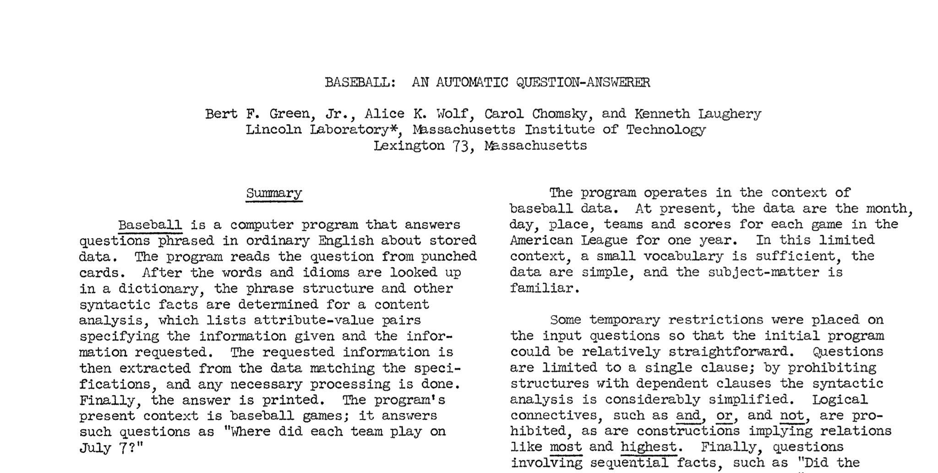
Notes:
2m 30s

Slide 11
QA History
Old systems used Pattern-Matching approaches.
ANN were used to improve accuracy (IBM’s deepQA system (2010)).
Deep learning approach created a break through!
In Arabic, SOQAL (2019) is an example of using the deep learning approach.
Notes:
2. IBM’s deepQA system (2010)

Slide 12
Question Generation
Notes:
1m

Slide 13
QG History
Old systems used Rule-Based approaches (QUALM 1970).
Template-Based approach (NL Generation system by the University of Aberdeen in 2004).
Hybrid systems (UniLM, Microsoft 2020).
Deep learning approach (UniLMv2, Microsoft 2021).
In Arabic, AQG (2022) is an example of an Arabic QG system using deep learning.
Notes:
1. QUALM 1970
2. Natural Language Generation system developed by the University of Aberdeen in 2004

Slide 14
QA & QG Combined
Notes:
1m

Slide 15
Related Work
Quillionz
Questgen
PrepAI
ChatGPT
Notes:
15s

Slide 16


Notes:
1m

Slide 17

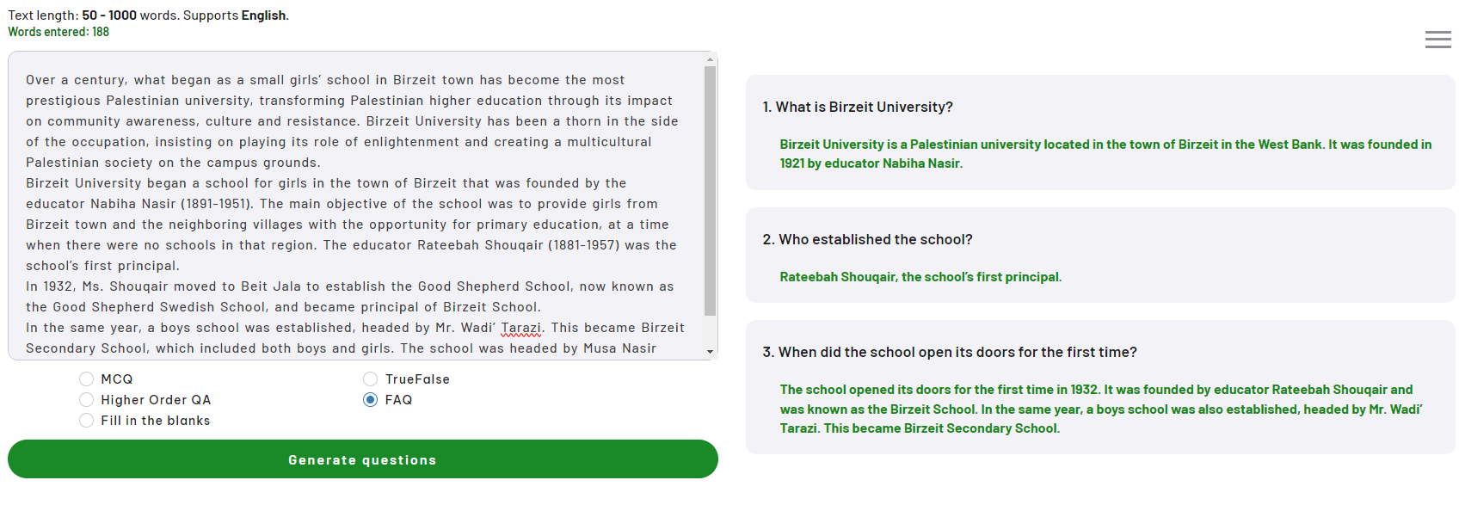
Notes:
30s

Slide 18

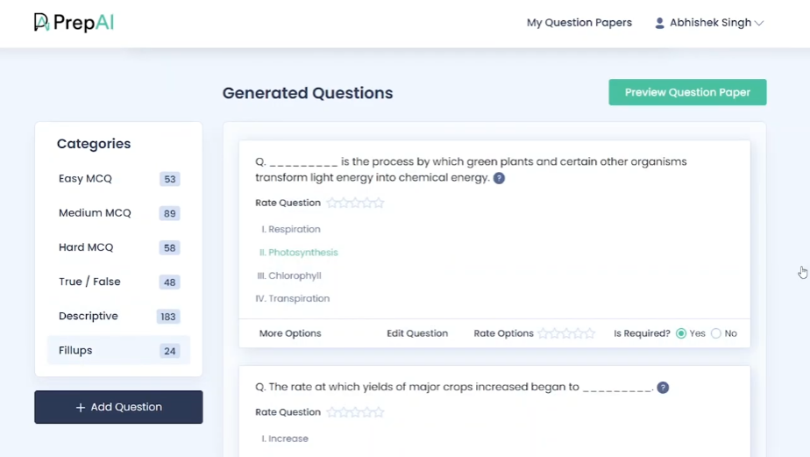
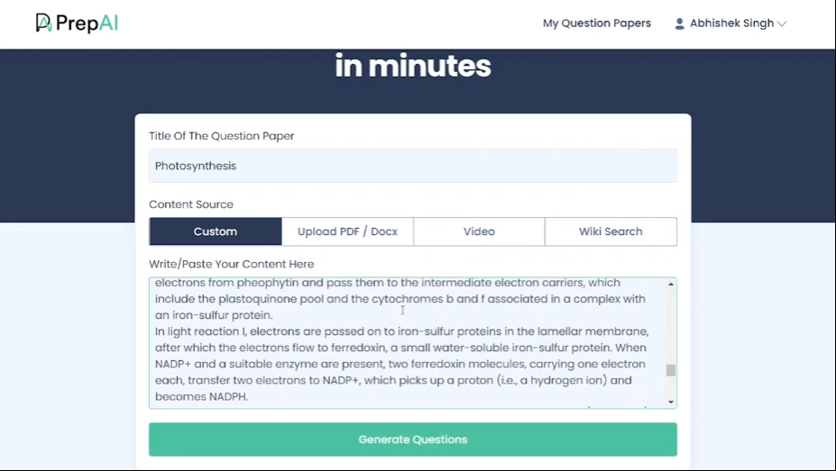
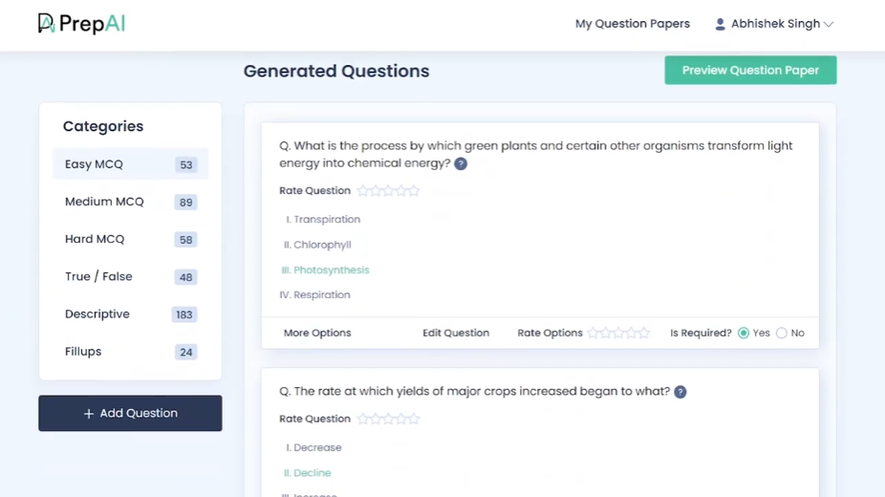
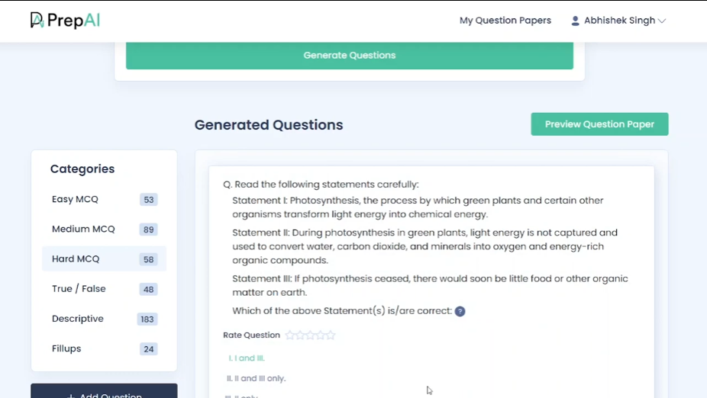
Notes:
1m

Slide 19

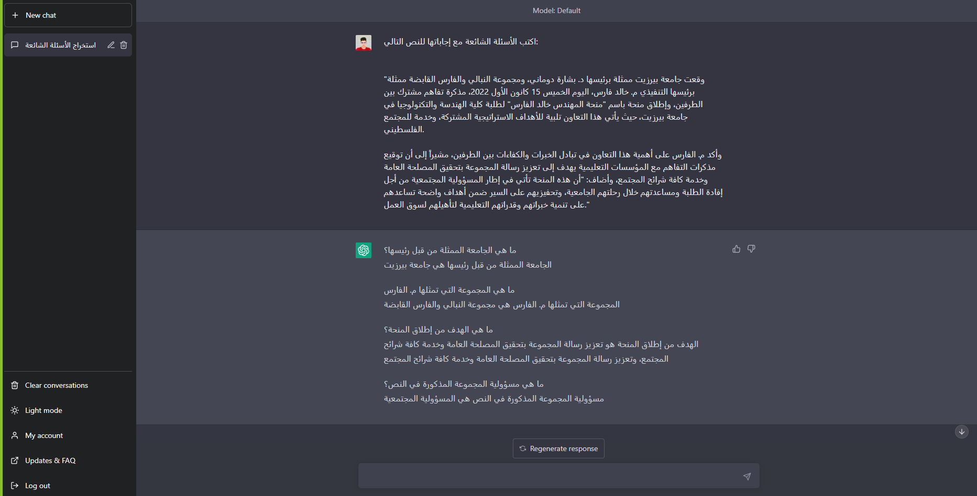
ChatGPT
Notes:
1m

Slide 20

Language
Transformer
Models
Vaswani, Ashish, Noam Shazeer, Niki Parmar, Jakob Uszkoreit, Llion Jones, Aidan N. Gomez, Łukasz Kaiser, and Illia Polosukhin. "Attention is all you need." Advances in neural information processing systems 30 (2017).
Notes:
1m 15s

Slide 21

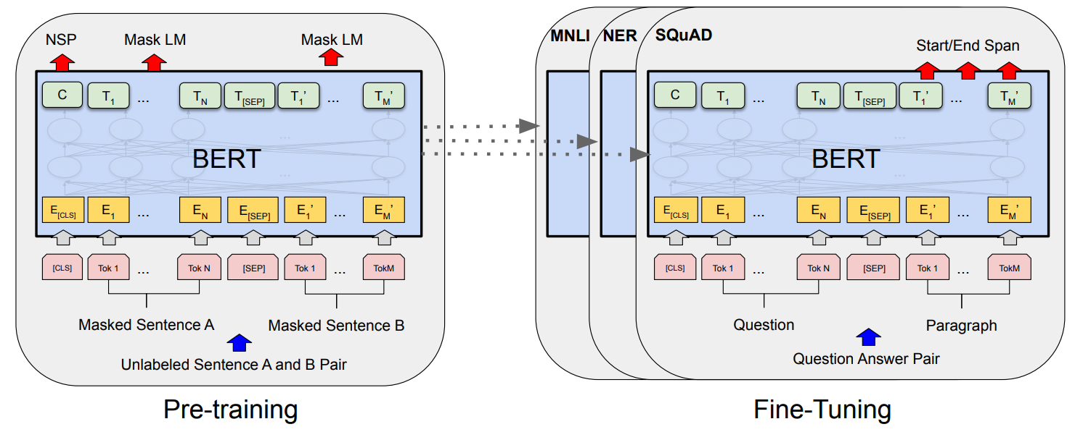
BERT
Bidirectional Encoder Representations from Transformers
Devlin, Jacob, Ming-Wei Chang, Kenton Lee, and Kristina Toutanova. "Bert: Pre-training of deep bidirectional transformers for language understanding." arXiv preprint arXiv:1810.04805 (2018).
Notes:
50s

Slide 22
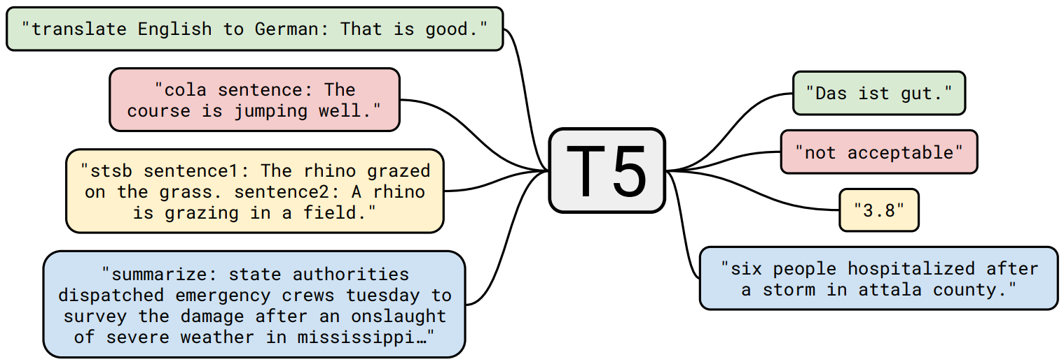
T5
Text-to-Text Transfer Transformer
Raffel, Colin, Noam Shazeer, Adam Roberts, Katherine Lee, Sharan Narang, Michael Matena, Yanqi Zhou, Wei Li, and Peter J. Liu. "Exploring the limits of transfer learning with a unified text-to-text transformer." The Journal of Machine Learning Research 21, no. 1 (2020): 5485-5551.
Notes:
25s

Slide 23
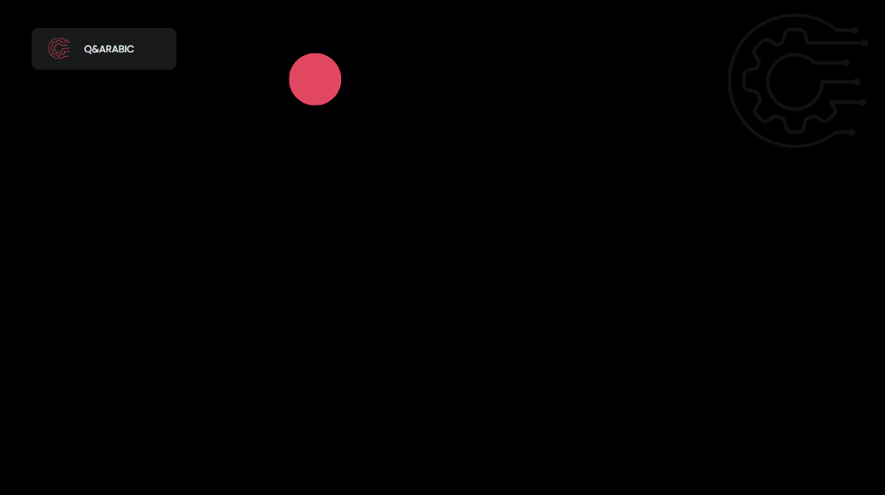
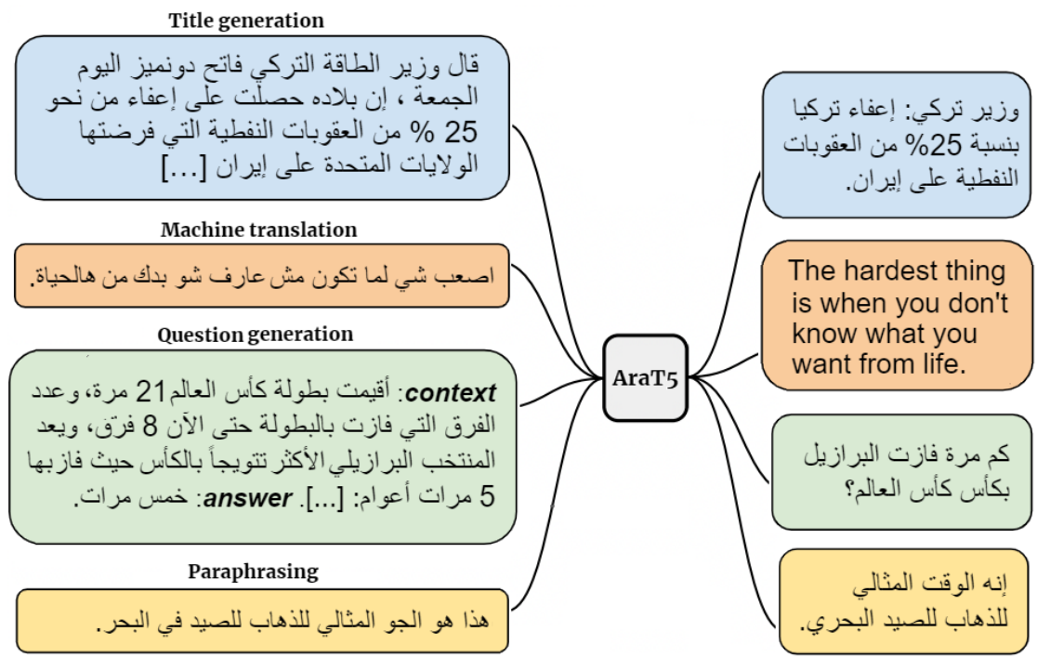
AraT5
Elmadany, AbdelRahim, and Muhammad Abdul-Mageed. "AraT5: Text-to-text transformers for Arabic language generation." In Proceedings of the 60th Annual Meeting of the Association for Computational Linguistics (Volume 1: Long Papers), pp. 628-647. 2022.
Notes:
15s

Slide 24
Datasets
Dataset | # Q/A Pairs | # Paragraphs | # Articles
Arabic-SQuAD | 48,344 | 10,364 | -
AAQAD | 17,911 | 3,381 | 299
TyDiQA | 16,425 | 15,726 | -
MLQA | 5,852 | 5,085 | 2,627
ARCD | 1,395 | 465 | 155
Total | 89,927 | 35,021 | -
Notes:
15s

Slide 25
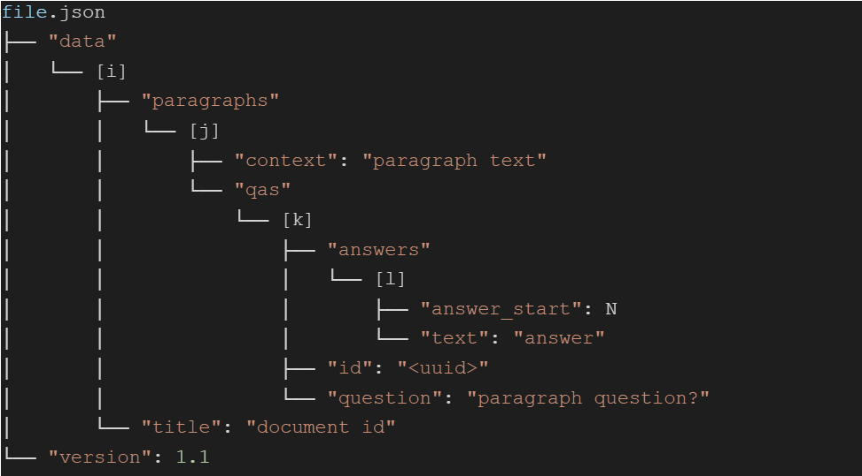
Notes:
10s

Slide 26
Proposed System

Slide 27
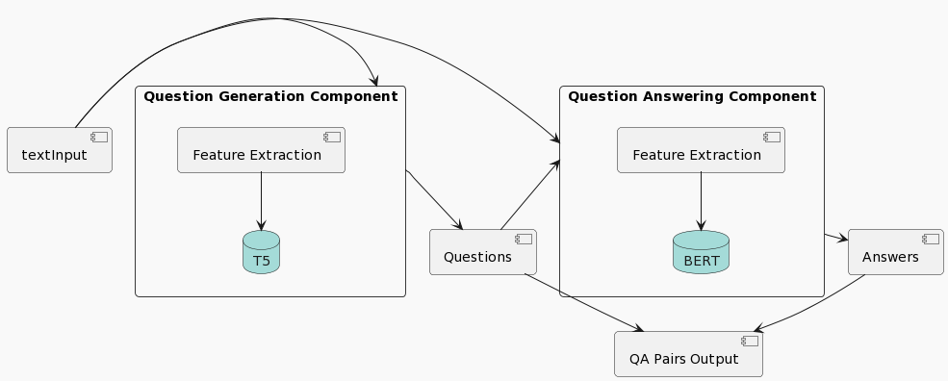
System Architecture
Notes:
30s

Slide 28
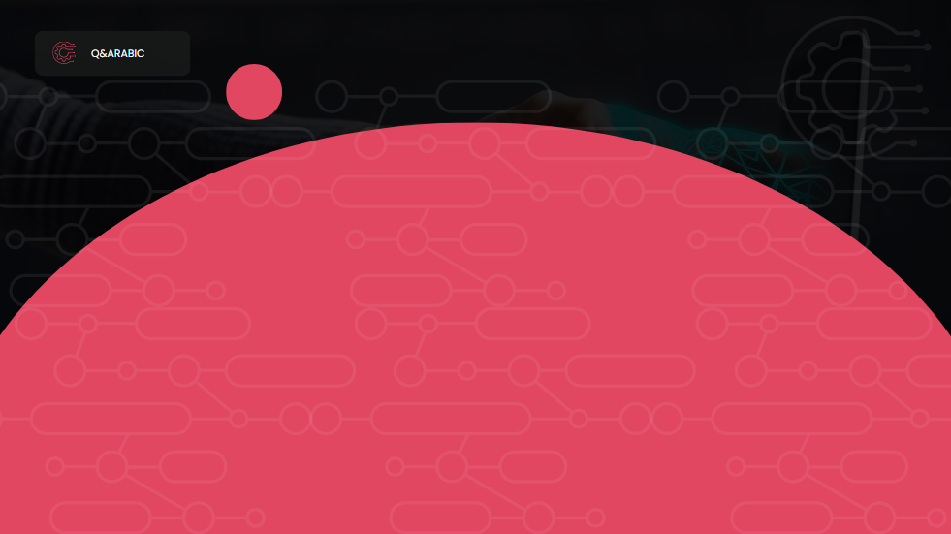





Operating Environments
Notes:
30s

Slide 29
GUI Mockups
Notes:
1m

Slide 30
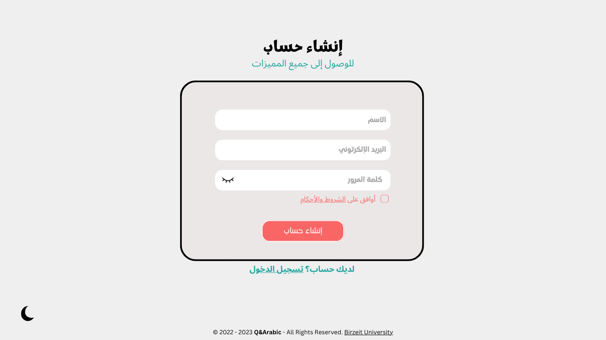
Notes:
10s

Slide 31
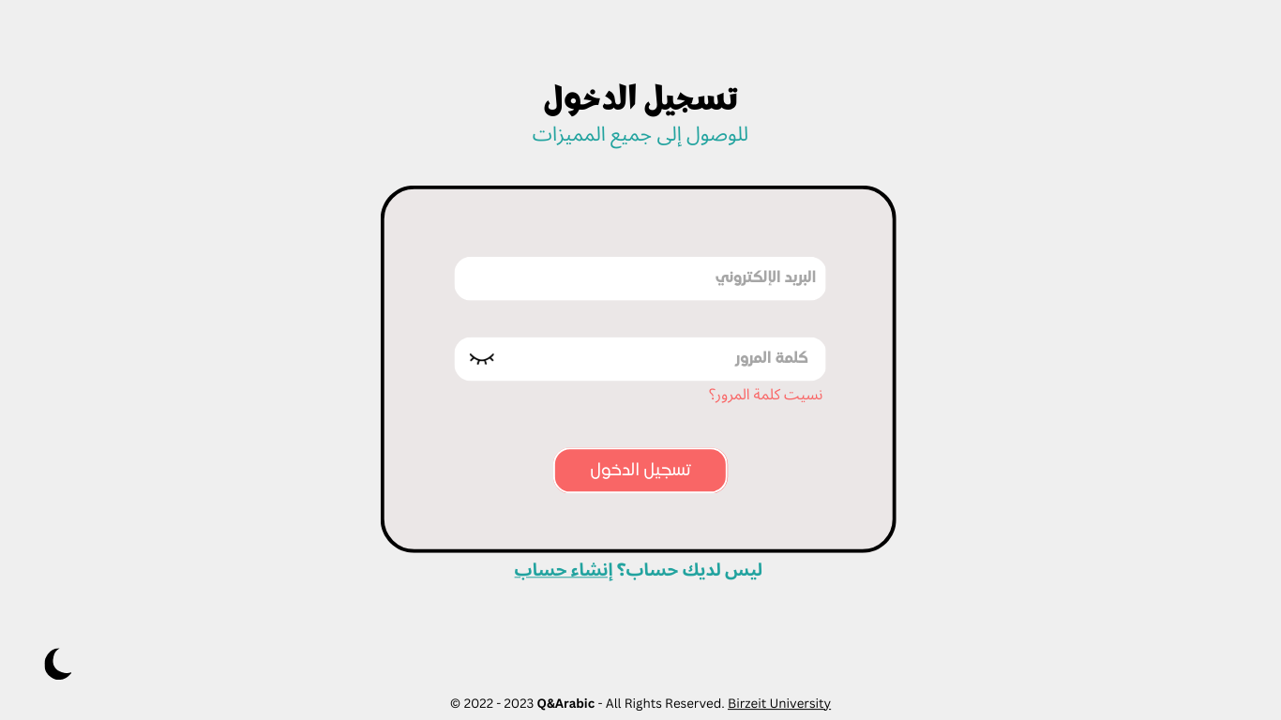
Notes:
4s

Slide 32
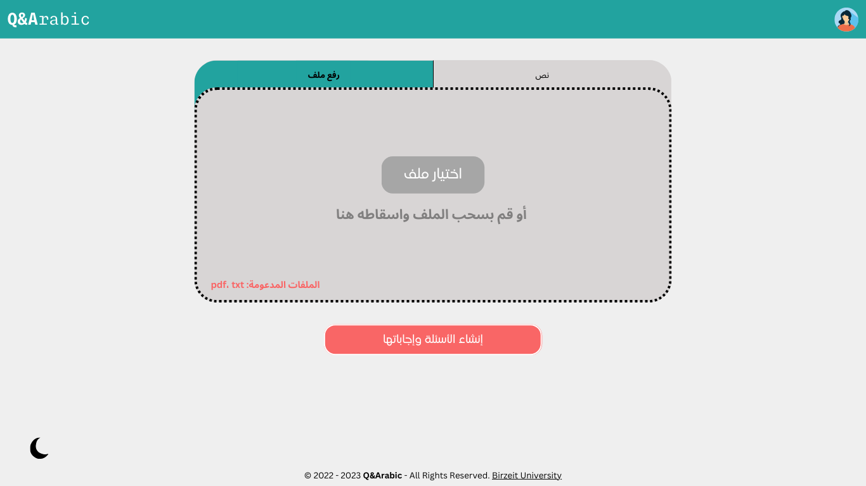
Notes:
10s

Slide 33
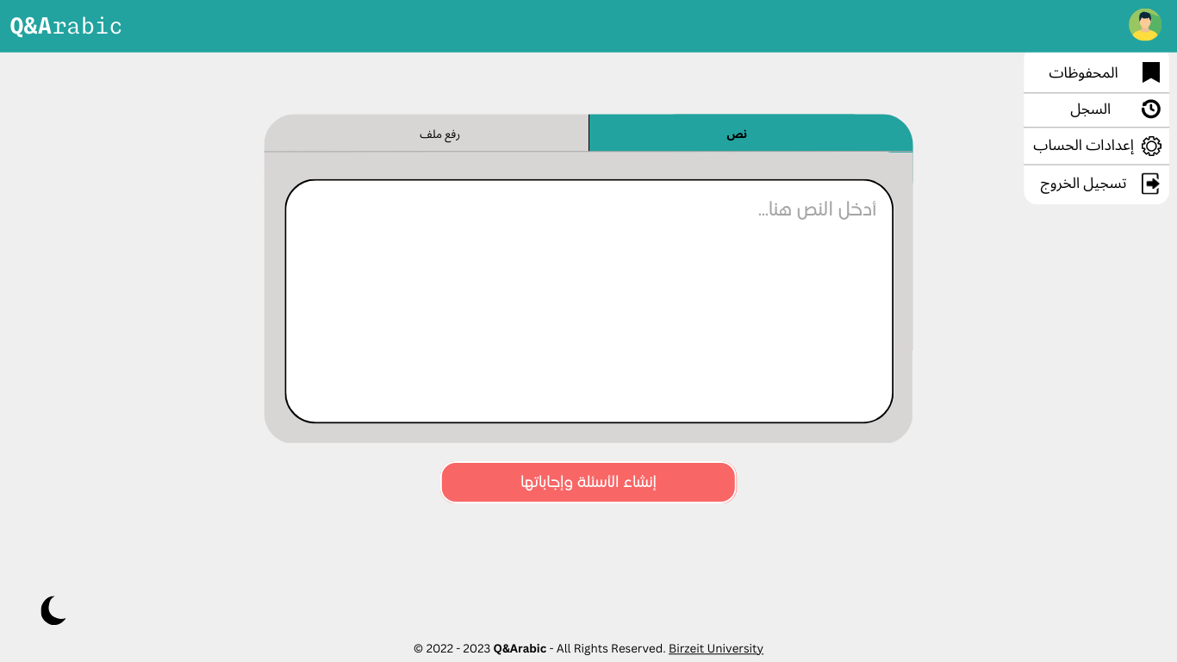
Notes:
10s

Slide 34
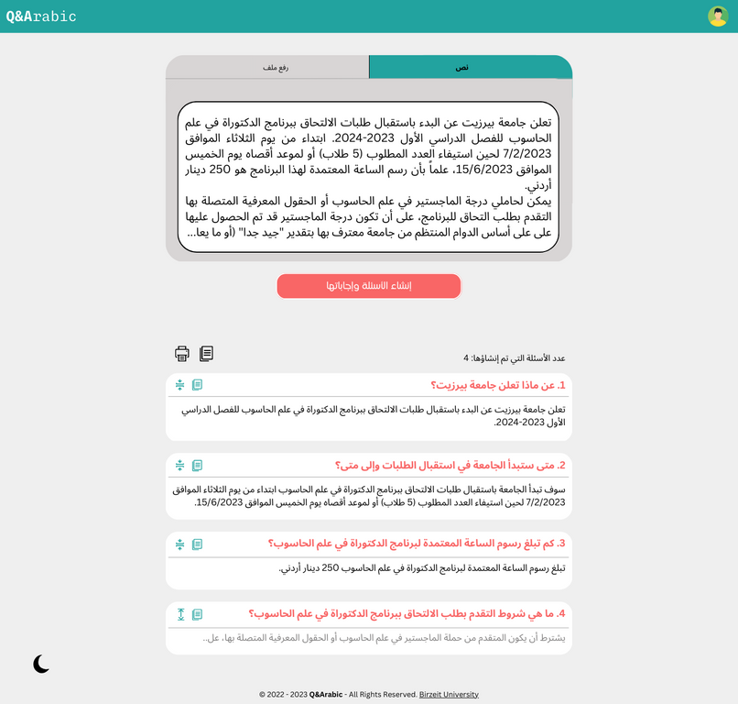
Notes:
20s

Slide 35
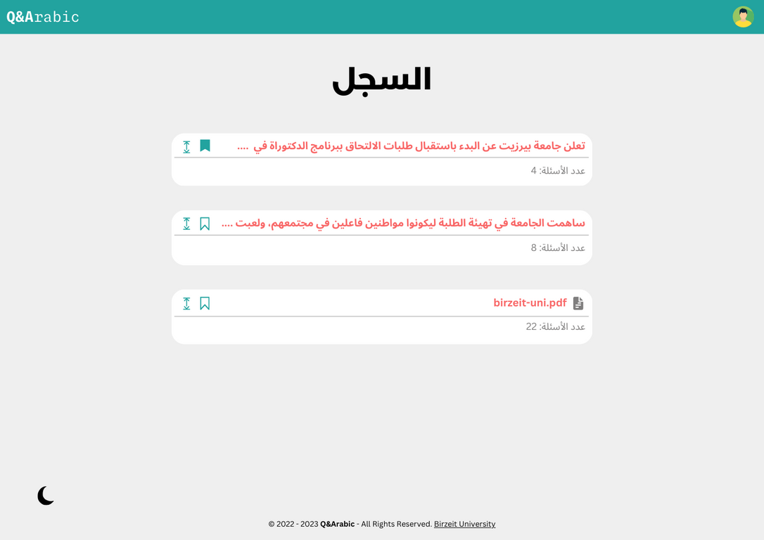
Notes:
7s

Slide 36
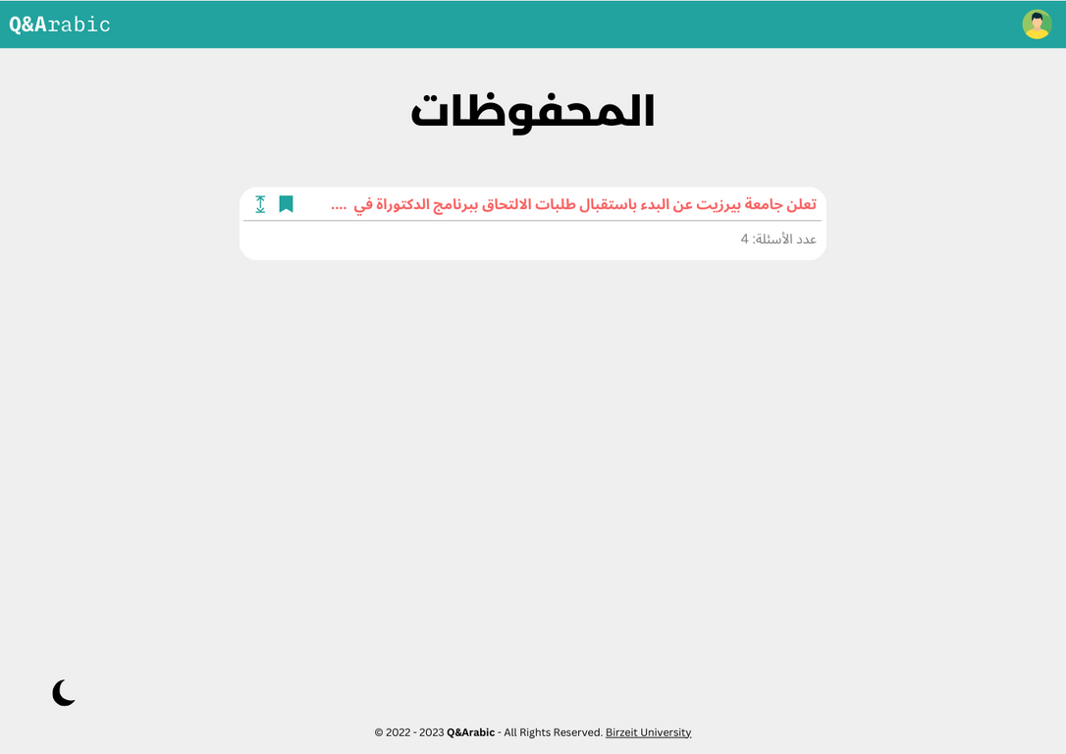
Notes:
3s

Slide 37
System Diagrams

Slide 38
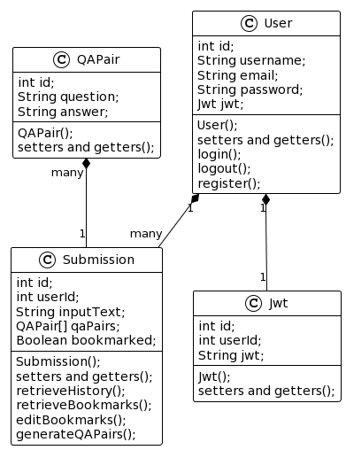
Class Diagram
Notes:
40s

Slide 39
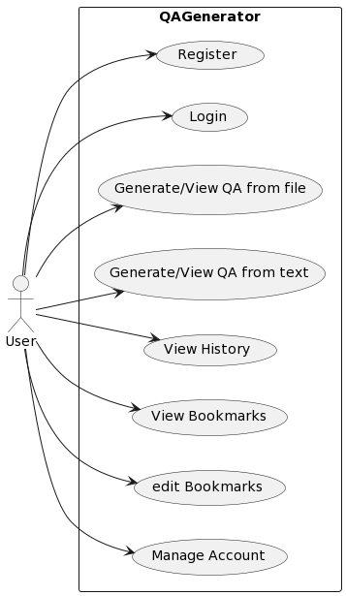
Use Case Diagram
Notes:
20s

Slide 40
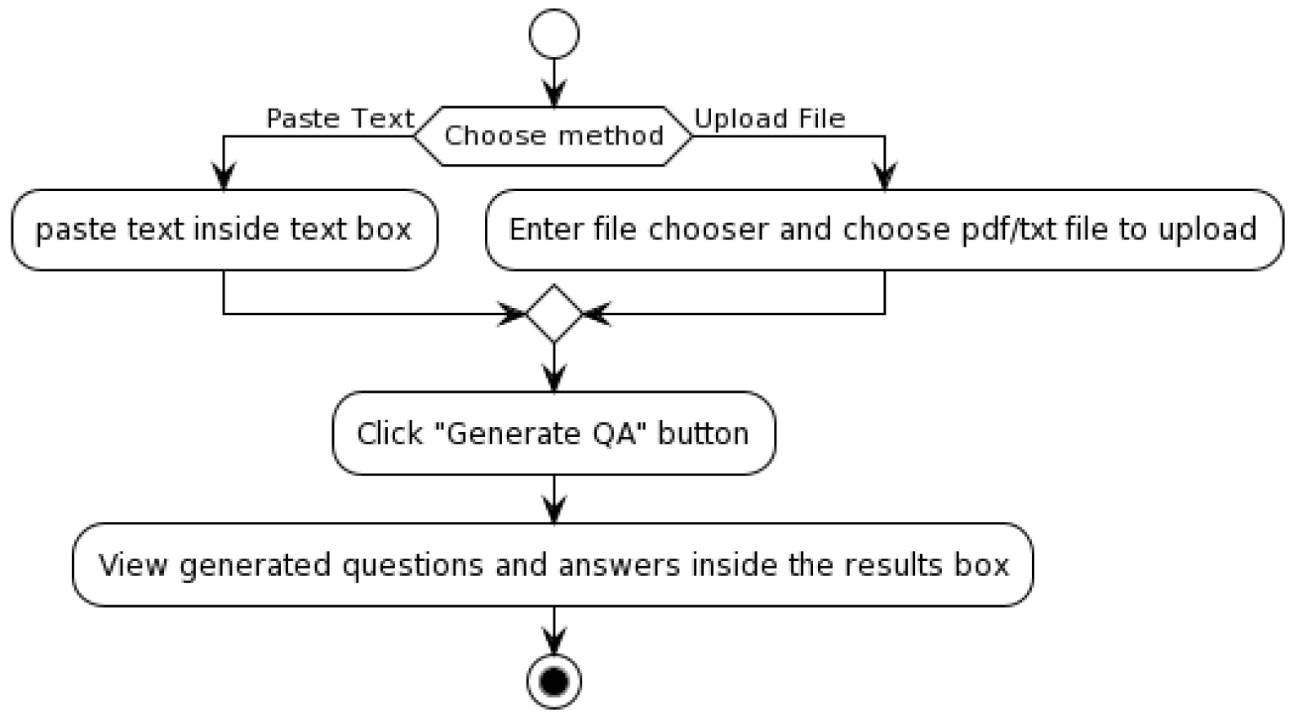
QA Generation Activity Diagram
Notes:
25s

Slide 41
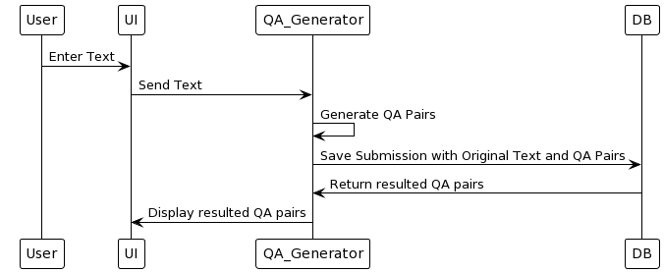
QA Generation Sequence Diagram
Notes:
25s

Slide 42
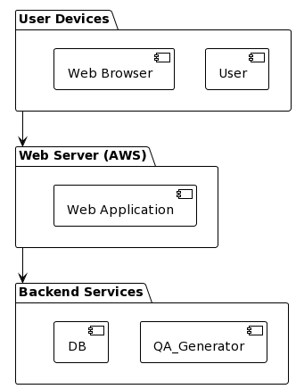
Deployment Diagram
Notes:
15s

Slide 43
FUTURE PLAN
Transformer Models Fine-Tuning.
Back-end Service Implementation.
Front-end Service Implementation.
Deployment.
Notes:
25s

Slide 44
THANK YOU
Notes:
25s

